Slide 1
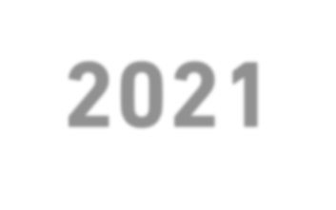


ITIL^{®4}
2021
Foundation Course
للمهندس / سعود محمد
Eng. Saud: PMP® , RMP® , PMI-SP® , PBA® , ACP® , Project+® , P3O® , ITIL®

Slide 2







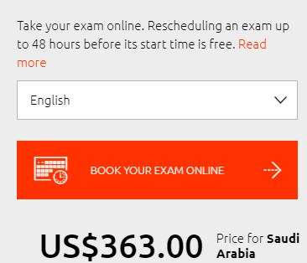
ITIL Foundation Exam
60 دقيقة
60 minutes
40 questions
26 marks PASS (65%)
MCQs
(Multiple Choice Questions)
40 سؤال
26 درجة للنجاح (65%)
أسئلة اختيار متعدد
NO Pre-Requests
لا يوجد متطلبات
لدخول الاختبار

Slide 3
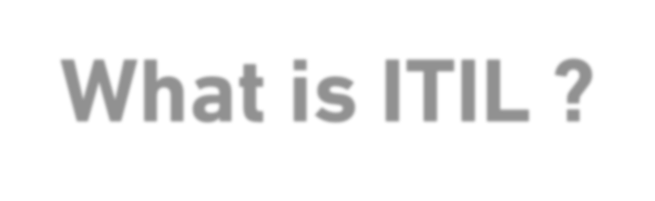


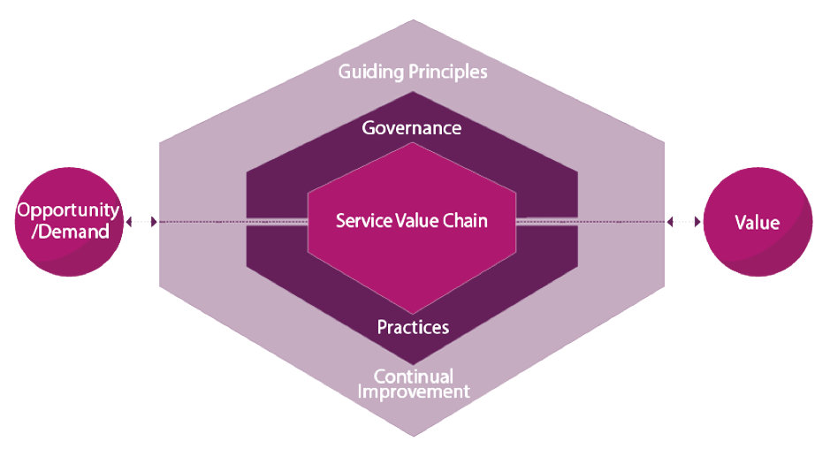
What is ITIL ?
Information Technology Infrastructure Library
Provides the guidance organizations need to address new
service management challenges.
Designed to ensure a flexible, coordinated and integrated system for the effective management of IT-enabled services.
Best practices for delivering IT service management (ITSM)
الإرشادات التي تحتاجها المنظمات لمواجهة تحديات
إدارة خدمة جديدة.
ضمان نظام مرن ومنسق ومتكامل للادارة الفعالة
للخدمات التي تدعم تكنولوجيا المعلومات.
أفضل الممارسات لتقديم ادارة خدمات تكنولوجيا
المعلومات.
Represents how the various activities of the organization work together to facilitate value creation through IT-enabled services.
يمثل كيفية عمل الأنشطة المختلفة للمؤسسة معًا لتسهيل إنشاء القيمة من خلال الخدمات التي تدعم تقنية المعلومات.
The ITIL Service Value System (SVS)

Slide 4

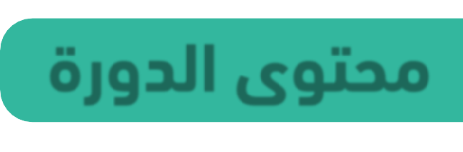

Course Content
ةمدخلا ةرادإ
Concepts of Service Management
ةيهيجوتلا ئدابملا
ITIL Guiding Principles 6
5 Questions
داعبلأا
بيردت
مهف
The Four Dimensions of Service Management
2
فدهلا ةميق
تانوكم
Purpose and Components of the ITIL Service Value System
1
ةلسلس
Service Value Chain 2
ةعجارم
رابتخا
تاسرامم
Purpose and Key Terms of 15 ITIL Practices
7
Understand 7 ITIL Practices 17

Slide 5




Concepts of Service Management
Service Management:
ةصصختم تاردق
A set of specialized organizational capabilities for enabling value for customers in
the form of services.
Developing the specialized organizational capabilities requires an understanding of:
The nature
of value
The nature and scope of the stakeholders involved
How value creation is enabled through services
نيينعملا

Slide 6

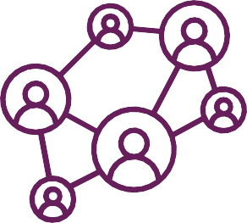
Concepts of Service Management
“The purpose of an organization is to create value for stakeholders”
Value:
دئاوف
ةعفنم
ةيمهأ
The perceived benefits, usefulness, and importance of something
Value co-creation
نواعت
Value is co-created through an active collaboration between providers and consumers, as well as other organizations that are part of the relevant service relationships
مدقم/دوّ زم كلهتسم

Slide 7

Concepts of Service Management
Organization:
فئاظو تايلوؤسم
A person or a group of people that has its own functions with responsibilities,
authorities, and relationships to achieve its objectives.
تايحلاص
فادهأ
مدقت ةمدخلا مدقم When provisioning services, an organization takes on the role of the service provider. The provider يجراخ can be external to the consumer’s organization, or they can both be part of the same organization.
لصحت/ملتست ةمدخلا كلهتسم/بلاط When receiving services, an organization takes on the role of the service consumer.

Slide 8
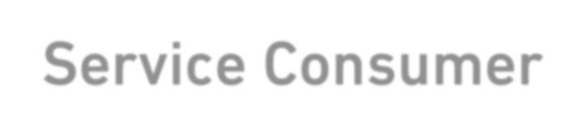
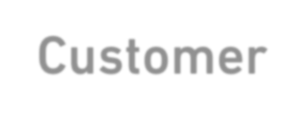
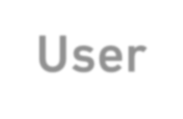

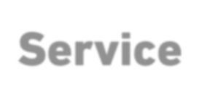

Concepts of Service Management
Service Consumer
Customer
User
Sponsor
تابلطتم _{nts for a}
A person who
uses services
A person who defines the requireme
A person who authorizes
budget for service consumption
service and takes responsibility for the
outcomes of service consumption
ةينازيم
جئاتن
A means of enabling value co-creation by facilitating outcomes that customers
want to achieve, without the customer having to manage specific costs and risks

Slide 9

Concepts of Service Management
What role do service providers and service consumers have in relation to risk?
Consumer help service provider to achieve outcomes, which reduces service provider risk
Consumer should manage the detailed level of risk on behalf of service provider
Service provider help consumer to achieve outcomes, which eliminate consumer risk
Service provider should manage the detailed level of risk on behalf of the consumer

Slide 10
Concepts of Service Management
What role do service providers and service consumers have in relation to risk?
a)
b)
Consumer
help service provider to achieve outcomes, which reduces service provider risk
Consumer
should manage the detailed level of risk on behalf of service
provider
c) Service provider help consumer to achieve outcomes, which
eliminate
consumer risk
d) Service provider should manage the detailed level of risk on behalf of the consumer

Slide 11

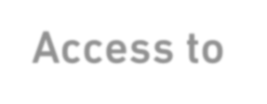

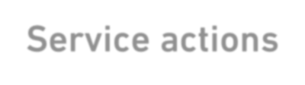
Concepts of Service Management
نيوكت/بيترت
Product: A configuration of an organization’s resources designed to offer value for a consumer.
يمسر فصو
Service Offering: A formal description of one or more services, designed to address the needs of a
target consumer group. A service offering may include goods, access to resources, and service actions.
Component | Description | Examples
Goods | Supplied to the consumer Ownership is transferred to the consumer Consumer takes responsibility for future use | A mobile phone A physical server
Access to resources | Ownership is not transferred to the consumer Access is granted or licensed to the consumer under agreed terms and conditions The consumer can only access the resources during the agreed consumption period and according to other agreed service terms | Access to the mobile network, or to network storage
Service actions | Performed by the service provider to address a consumer’s needs Performed according to an agreement with the consumer | User support Replacement of a piece of equipment

Slide 12

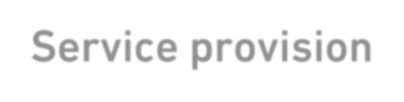
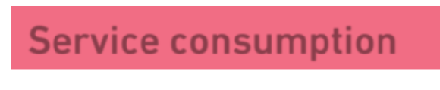
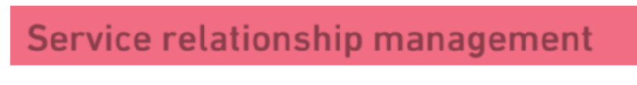
Concepts of Service Management
“Service relationships are established between two or more organizations to co-create value”
نواعت
Service Relationship: A cooperation between a service provider and service consumer.
include
Service provision
Activities performed by an organization to provide services.
Service consumption
Activities performed by an organization to consume services
Service relationship management
ةكرتشم ةطشنأ
Joint activities performed by a service provider and a service consumer to ensure
continual value co-creation based on agreed and available service offerings

Slide 13
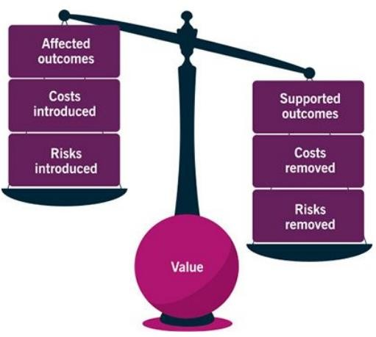

Concepts of Service Management
“Acting as a service provider, an organization produces outputs that help its consumers to achieve certain outcomes.”
_{Output:} سوملم/يدام
يدام ريغ
A tangible or intangible deliverable of an activity.
Outcome: A result for a stakeholder enabled by one or more outputs.
Input
Input
Output Output Output
Activity
Output
Outcome
Which describe outcomes?
Tangible or intangible deliverables
Functionality offered by a product or service
Results desired by stakeholder
Configuration of an organization's recourse

Slide 14
Concepts of Service Management
“Acting as a service provider, an organization produces outputs that help its consumers to achieve certain outcomes.”
_{Output:} سوملم/يدام
يدام ريغ
A tangible or intangible deliverable of an activity.
Outcome: A result for a stakeholder enabled by one or more outputs.
Input
Input
Output Output Output
Activity
Output
Outcome
Which describe outcomes?
Tangible or intangible deliverables
Functionality offered by a product or service
Results desired by stakeholder
(output)
(utility)
(product)
d) Configuration of an organization's recourse

Slide 15
Concepts of Service Management
Cost: The amount of money spent on a specific activity or resource.
From the service consumer’s perspective, there are
two types of cost involved in service relationships:
ةضورفم
costs imposed on the
consumer by the service
(the costs of service consumption)
The total cost of consuming a service includes:
the price charged by the service provider (if applicable), plus other costs such as staff training, costs of network utilization, procurement, etc.
costs removed from the
consumer by the service
(a part of the value proposition) This may include:
costs of staff, technology, and other resources, which the consumer does not need to provide

Slide 16
Concepts of Service Management
نيقي مدع / كش
_{Risk:}
A Possible event that could cause harm or loss, or make it more
difficult to achieve objectives. Can also be defined as uncertainty of outcome, and can be used in the context of measuring the probability of positive outcomes as well as negative outcomes.
From the service consumer’s perspective, there are
two types of risk:
risk removed from the
consumer by the service
risk imposed on the
consumer by the service

Slide 17



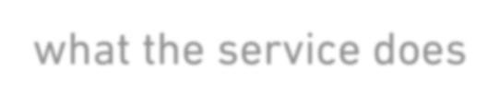


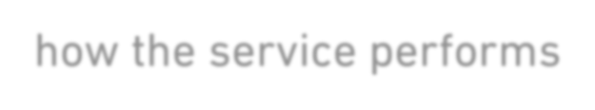

Concepts of Service Management
To evaluate whether a service or service offering will facilitate the outcomes desired by the consumers
and therefore create value for them, the overall utility and warranty of the service should be assessed.
Utility ‘what the service does’
Warranty ‘how the service performs’
The functionality offered by a product or service
to meet a particular need.
Determine whether a service is ‘fit for purpose’.
Assurance that a product or service will meet
agreed requirements.
Determine whether a service is ‘fit for use’.

Slide 18


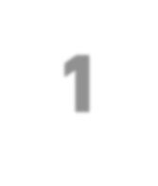






Concepts of Service Management
ما هو المصطلح الذي يصف ما تفعله الخدمة؟
ضمان
قيمة
خدمة
علاقات الخدمة
Which term describe what a service does?
Warranty
Value
Utility
Service Relationships
how the service performs (Assurance (
Q. 1
The perceived benefits , usefulness, and importance of something
‘what the service does (functionality)
Relationships between a service provider and service consumer

Slide 19
ةمدخلا ةرادإ ميهافم
Concepts of Service Management
Which term describe what a service does?
Warranty
Value
Utility
Q. 1
d) Service Relationships

Slide 20



























Concepts of Service Management
ما هو النشاط المشترك الذي يقوم به مقدم الخدمة والخدمة المستهلك يضمن استمرار خلق القيمة المشتركة؟
تقديم الخدمات
استهلاك الخدمة
تقديم الخدمة
إدارة علاقات الخدمة
Which joint activity performed by a service provider and service
consumer ensures continual value co-creation?
Service Provision
Service consumption
Service offering
Service Relationships
management
Q. 2
Activities performed by an organization to provide services.
Activities performed by an organization to consume services
A formal description of one or more services, designed to address the needs of a target consumer group.
Joint activities performed by a service provider and a service consumer to ensure continual value co-creation based on agreed and available service offerings

Slide 21
ةمدخلا ةرادإ ميهافم
Concepts of Service Management
Which joint activity performed by a service provider and service
consumer ensures continual value co-creation?
Service Provision
Service consumption
Service offering
Q. 2
d) Service Relationships management

Slide 22
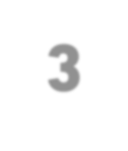








Concepts of Service Management
صيغة السؤال هذه ستتكرر يمكن 5 مرات
حدد الكلمة (الكلمات) المفقودة في الجملة التالية.
"إدارة الخدمة" هي مجموعة من القدرات التنظيمية المتخصصة لتمكين القيمة للعملاء في شكل [؟].
Identify the missing word(s) in the following sentence.
“Service management” is a set of specialized organizational
capabilities for enabling value for customers in the form of [?].
practices
warranty
services
IT assets
Q. 3
الممارسات
ضمان
خدمات
أصول تكنولوجيا المعلومات

Slide 23
ةمدخلا ةرادإ ميهافم
Concepts of Service Management
Identify the missing word(s) in the following sentence.
“Service management” is a set of specialized organizational
capabilities for enabling value for customers in the form of [?].
practices
warranty
Q. 3
services
IT assets

Slide 24








Concepts of Service Management
What is the definition of warranty?
a) A tangible or intangible deliverable that produced by carrying out an activity
output
The assurance that a product or service will meet agreed requirements
A possible event that could cause harm or loss, or make it more difficult to achieve objectives
The functionality offered by a product or service to meet a particular need
warranty
Q. 4
risk
utility
ما هو تعريف الضمان؟
ناتج ملموس أو غير ملموس تم إنتاجه من خلال تنفيذ نشاط.
ضمان تلبية المنتج أو الخدمة للمتطلبات المتفق عليها.
حدث محتمل يمكن أن يتسبب في ضرر أو خسارة ، أو يجعل تحقيق الأهداف أكثر صعوبة.
الوظيفة التي يوفرها منتج أو خدمة لتلبية حاجة معينة.

Slide 25
Concepts of Service Management
What is the definition of warranty?
a) A tangible or intangible deliverable that produced by carrying out an activity (output)
Q. 4
b) The assurance that a product or service will meet agreed requirements
A possible event that could cause harm or loss, or make it more difficult to achieve
objectives (risk)
The functionality offered by a product or service to meet a particular need (utility)

Slide 26

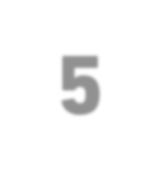
















Concepts of Service Management
Identify the missing word(s) in the following sentence.
A service is a means of enabling value co-creation by facilitating [?] that customers
Q. 5
want to achieve.
The warranty
outcomes
The utility
outputs
outcomes
provider
حدد الكلمة (الكلمات) المفقودة في الجملة التالية.
الخدمة هي وسيلة لتمكين خلق القيمة المشتركة من خلال تسهيل [؟] الذي يريد العملاء تحقيقه.
الضمان
النتائج
المنفعة
النواتج

Slide 27
ةمدخلا ةرادإ ميهافم
Concepts of Service Management
Identify the missing word(s) in the following sentence.
A service is a means of enabling value co-creation by facilitating [?] that customers
Q. 5
want to achieve.
The warranty
outcomes
The utility
outputs

